Slide 1

Three.js
3.JS
is
awesome
GUIDE FOR BEGINNERS
PROJECT PROPOSAL

Slide 2
TOPIC 7:
ABOUT
BUDGET
PROJECT
TIMELINE
Full screen and Resizing
PROJECT PROPOSAL

Slide 3
INITIAL SCREENSIZE
HOW TO FIT TO THE SCREEN
TABLE OF CONTENTS
HOW TO MAKE THE CANVAS RESPONSIVE
HOW TO FIX ANNOYING SCROLL BAR AND EXTRA MARGIN
Initial screen size
How to fit to the screen
How to fix annoying scroll bar and extra margin
How to make the canvas responsive
01
02
03
04
PROJECT PROPOSAL

Slide 4

Initial screen size
Initial screen size
How to fit to the screen
How to fix annoying scroll bar and extra margin
How to make the canvas responsive
01

Slide 5
Initial screen size
How to fit to the screen
How to fix annoying scroll bar and extra margin
How to make the canvas responsive
When we start our project in Three.js, first we make a canvas in which we do all our three.js stuff. And that canvas is of fixed resolution of 800x600.
Picture in the next slide shows the default size of canvas when the renderer get size of 800x600.

Slide 6
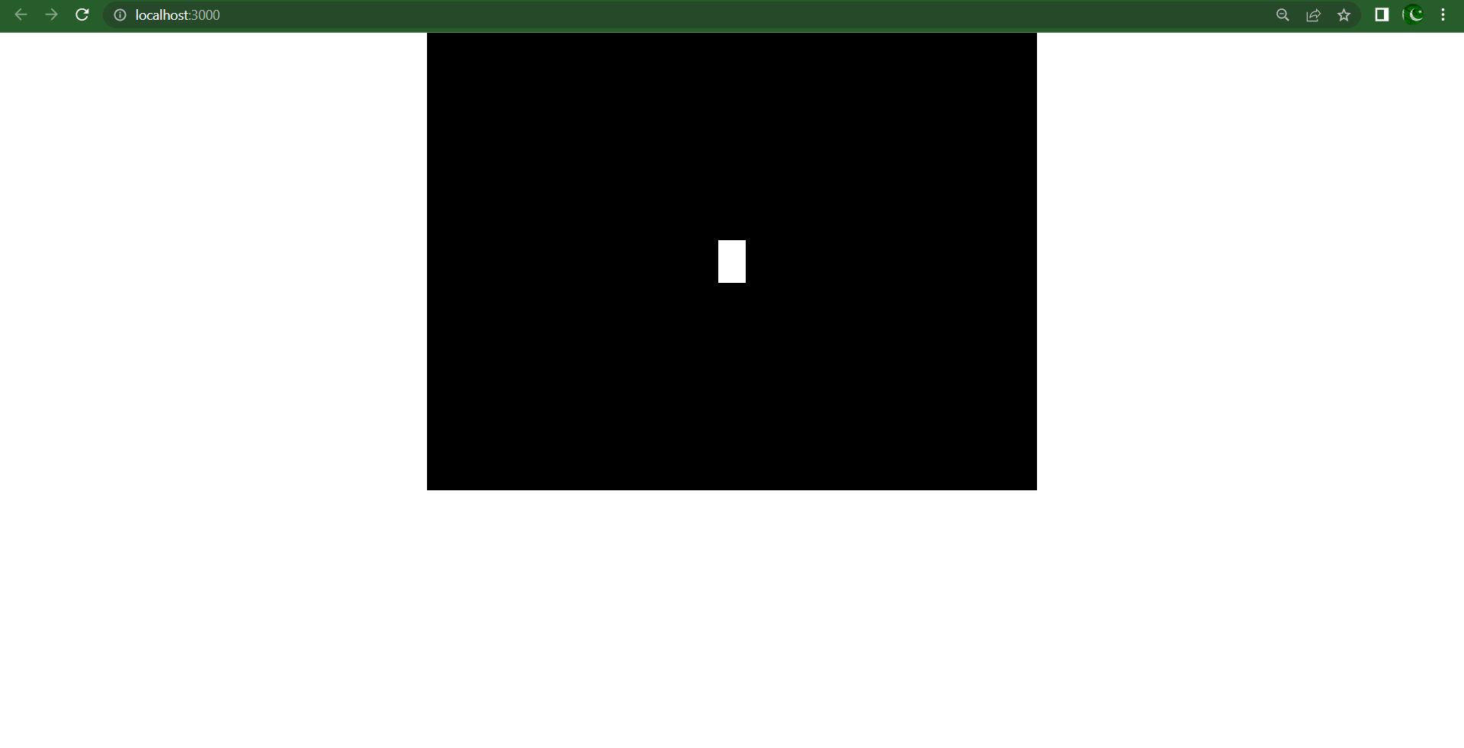
Initial screen size
How to fit to the screen
How to fix annoying scroll bar and extra margin
How to make the canvas responsive

Slide 7

How to fit to the screen
Initial screen size
How to fit to the screen
How to fix annoying scroll bar and extra margin
How to make the canvas responsive
02

Slide 8
Initial screen size
How to fit to the screen
How to fix annoying scroll bar and extra margin
How to make the canvas responsive
To make it look good, we fit the canvas to the screen. And we do that by giving the renderer size the values;
Width: window.innerWidth
Height: window.innerHeight
And the picture in the next slide is what we got.
But there we see that we get a margin at the bottom and a scroll bar at the right which is quite annoying.

Slide 9
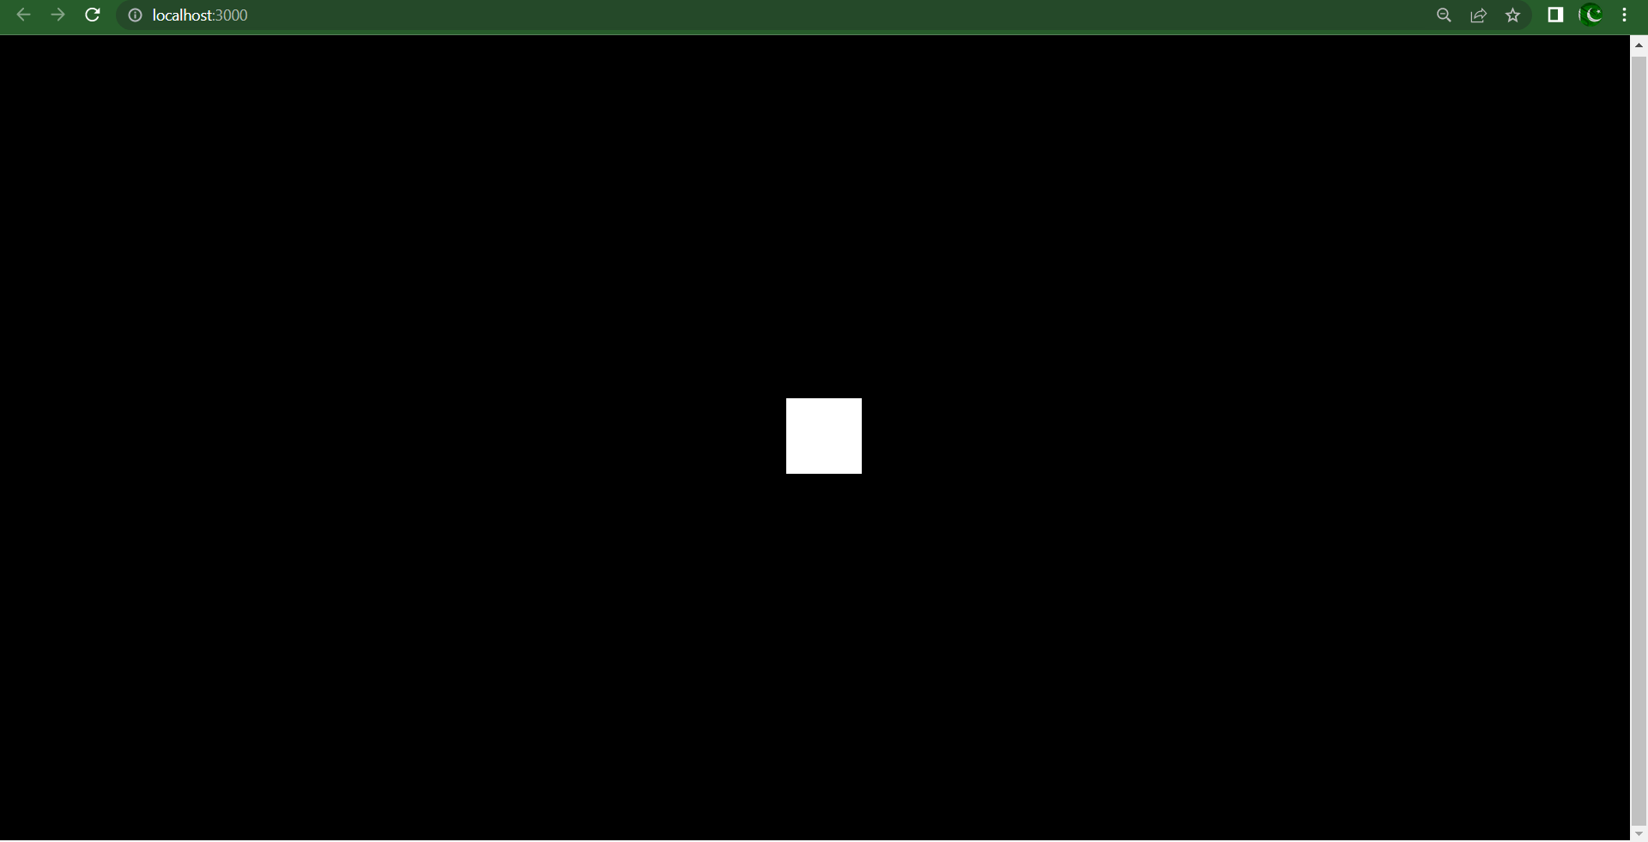
Initial screen size
How to fit to the screen
How to fix annoying scroll bar and extra margin
How to make the canvas responsive

Slide 10
How to fix annoying scroll bar and extra margin
Initial screen size
How to fit to the screen
How to fix annoying scroll bar and extra margin
How to make the canvas responsive
03

Slide 11
Initial screen size
How to fit to the screen
How to fix annoying scroll bar and extra margin
How to make the canvas responsive
Now the problem is unnecessary scrollbar at the right and margin at the bottom.
So we fix the with the help of a little bit css.
We will set everything’s margin and padding 0.
*{
margin: 0;
padding: 0;
}
And the canvas position be absolute with make them at the top left of the screen.
.webgl{
position: fixed;
top: 0;
left: 0;
} ∴ <canvas className=“webgl”></canvas>
Picture in the next slide is the result.

Slide 12

Initial screen size
How to fit to the screen
How to fix annoying scroll bar and extra margin
How to make the canvas responsive

Slide 13
How to make the canvas responsive
Initial screen size
How to fit to the screen
How to fix annoying scroll bar and extra margin
How to make the canvas responsive
04

Slide 14
Initial screen size
How to fit to the screen
How to fix annoying scroll bar and extra margin
How to make the canvas responsive
All things are set but there is one final touch we have to give to the canvas. And that is giving responsiveness to our canvas.
If we change the size of the screen, we will notice that it doesn’t have any affect with our canvas until we refresh the page.
In order to do that, we will write a short code.
window.addEventListener('resize',()=>{
camera.aspect=window.innerWidth/window.innerHeight
camera.updateProjectionMatrix();
renderer.setSize(window.innerWidth,window.innerHeight)
}
)
Updating the parameters of camera.perspective’s aspect
Must be called whenever camera parameters is changed
Size of the renderer is changed according to the window’s width and height

Slide 15
THANKS!
ABOUT
BUDGET
PROJECT
TIMELINE
Do you have any questions?
EMAIL: aadnanshahh2001@gmail.com
GITHUB: https://github.com/AdnanShahSahb
Please keep this slide for attribution
PROJECT PROPOSAL

